Slide 1


Supporting your KS4 Child during Exam Revision
Support For Families: Supporting your child through exams

Slide 2

Exam Periods
9–11 May 2023
Year 10 Mocks: 4-5th and 9-11th May 2023 (12 school weeks away)
Mon. 15 May
Year 11 Exams start Monday 15th May (14 school weeks away)
Support For Families: Supporting your child through exams

Slide 3
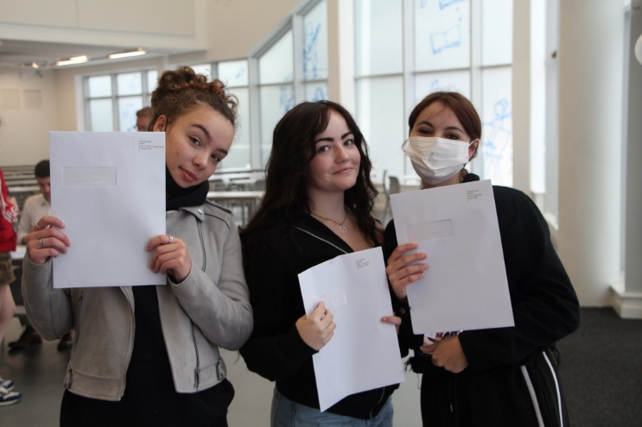
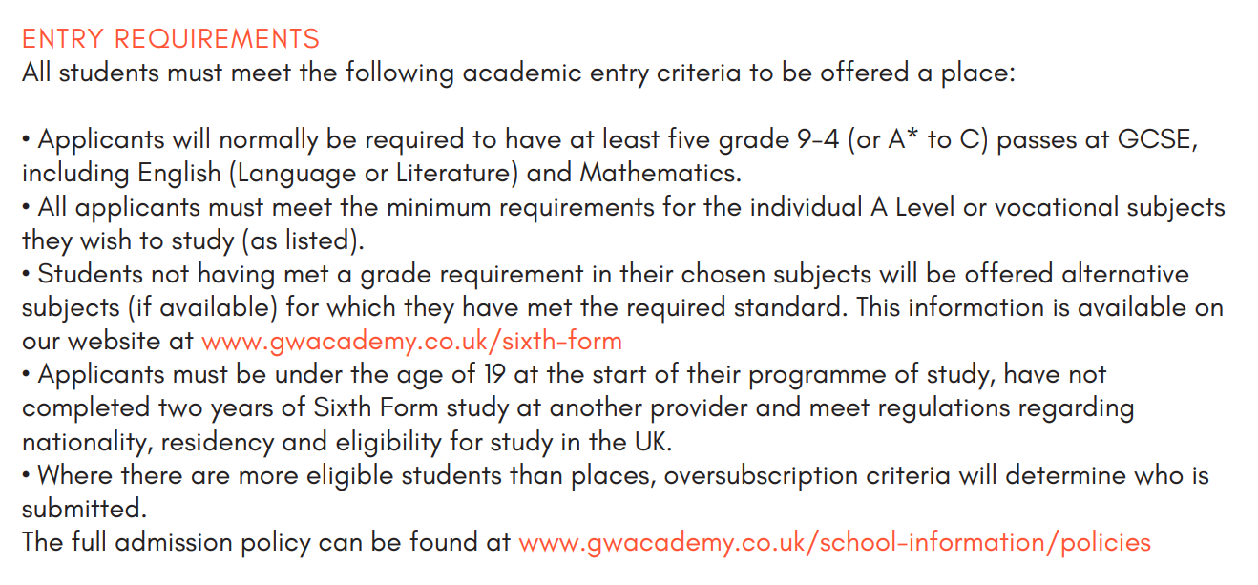
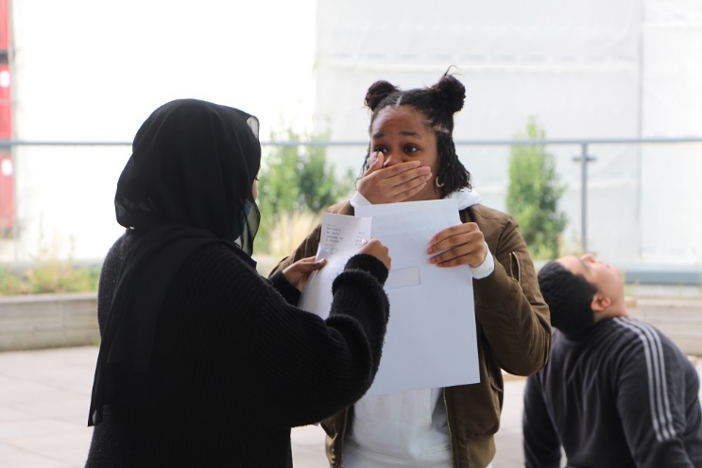
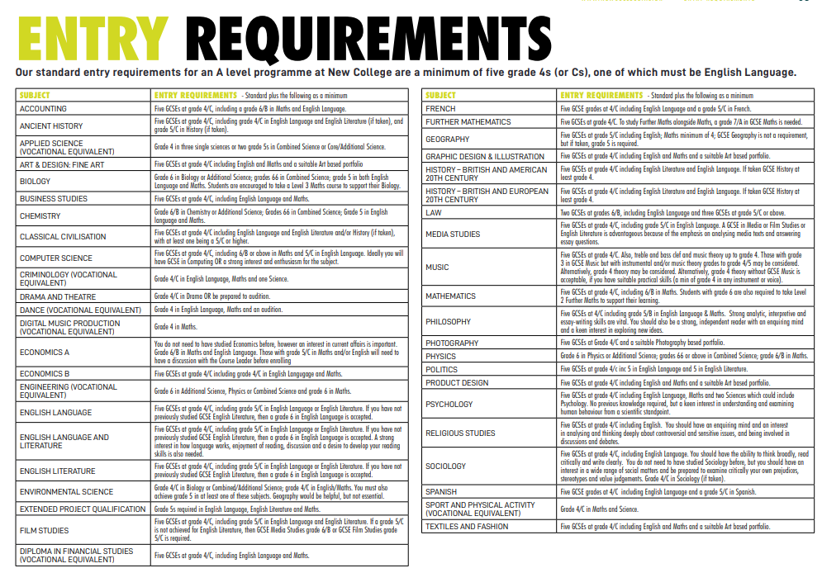
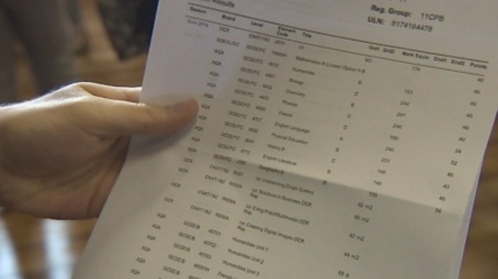
Support For Families: Supporting your child through exams

Slide 4
Summer 2022 Year 10 Exam Timetable
 | Fri-13-May | Mon-16-May | Tue-17-May | Wed-18-May | Thu-19-May
AM 1 8:30 - 10:30 2h | Biology 1 (1h45) Combined Science 1 (H) (1h15) Combined Science 1 (F) (1h15) (all students) | Maths Paper 1 (H) (1h30) Maths Paper 1 (F) (1h30) (all students) | Chemistry 1 (1h45) Combined Science 3 (H) (1h15) Combined Science 3 (F) (1h15) (all students) | Maths Paper 2 (H) (1h30) Maths Paper 2 (F) (1h30) (all students) | Physics 1 (1h45) Combined Science 5 (H) (1h15) Combined Science 5 (F) (1h15) (all students)
AM 2 10:50 - 12:50 2h00 | Spanish (1h) (Hall) French (1h) (E202) (100 students) | Business (1h30) (82 students) | Geography (1h30) Music (1h30) (78 students) | PE Theory (1h15) (86 students) | History (1h30) (74 students)
PM 1:30 - 3:30 2h | IT (1h45) Computing (1h30) (67 students) | English Language (1h45) (all students) | Food Preparation and Nutrition (1h45) Dance (1h30) (52 students) | DT (2h) Philosophy and Religion (1h45) (55 students) | English Literature (2h15) (all students)
Support For Families: Supporting your child through exams

Slide 5
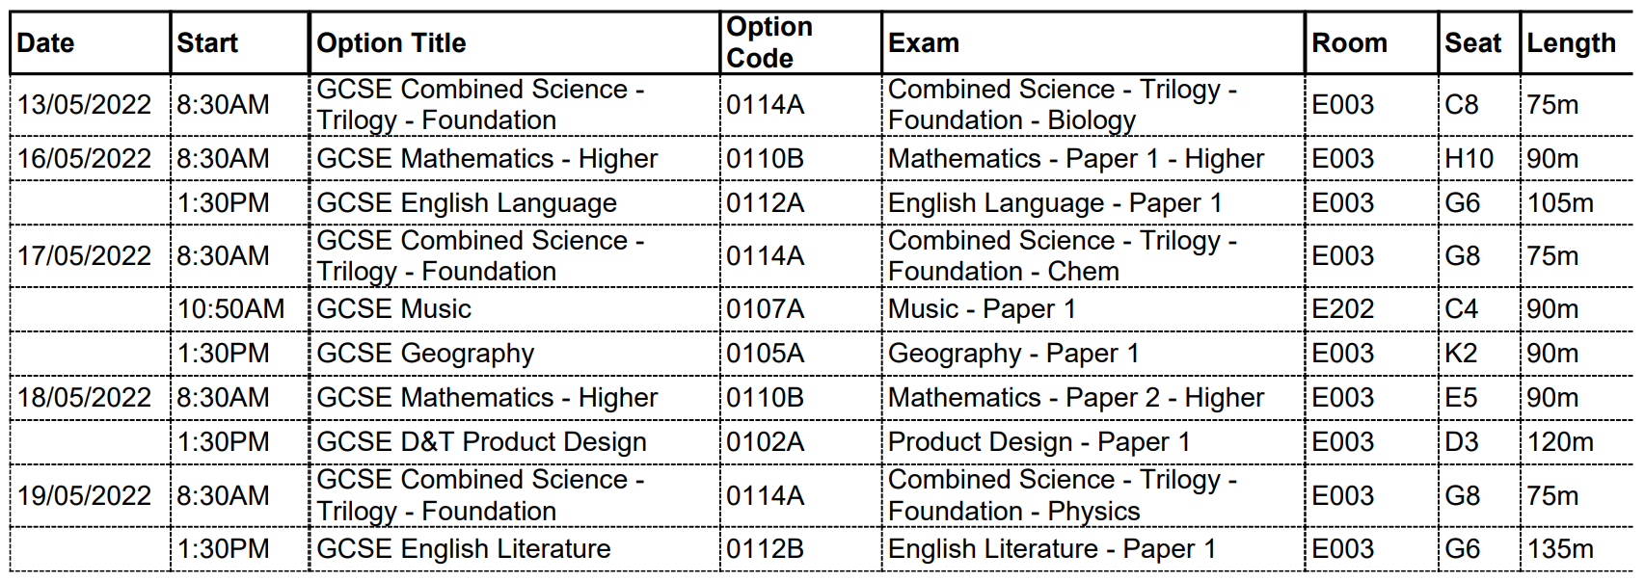
Individual Exam Timetables
Support For Families: Supporting your child through exams

Slide 6
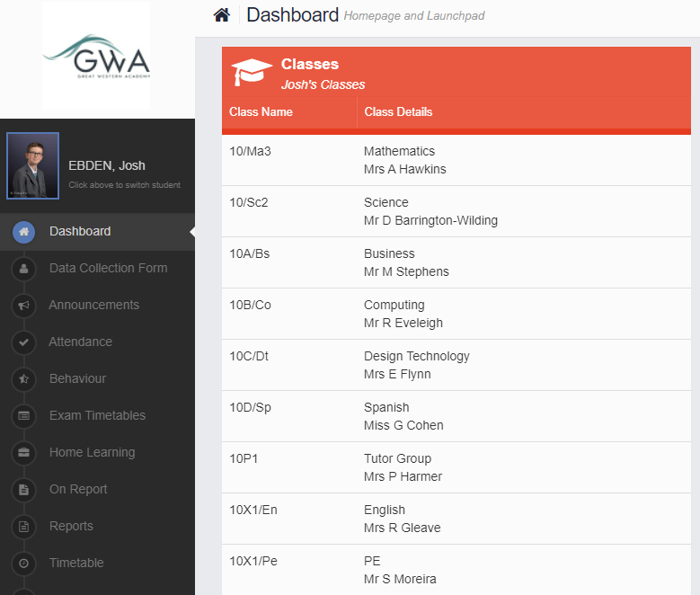
Individual Exam Timetables
Access MCAS online and navigate to ‘Exam Timetables’
Support For Families: Supporting your child through exams

Slide 7
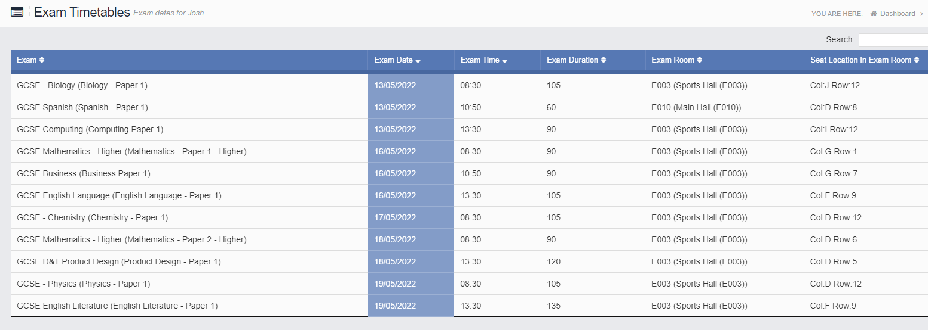
Individual Exam Timetables
Support For Families: Supporting your child through exams

Slide 8

Times & Routines
AM 1 Exams | start at 08.30
AM 2 Exams | start at 10.50
PM Exams | start at 13.30
Students must be on time to school – if they are late to the AM exam we cannot give any additional time.
This means arrival before 08.25 for line up and registration
Support For Families: Supporting your child through exams

Slide 9
Times & Routines
AM 1 Exams | start at 08.30
AM 2 Exams | start at 10.50
PM Exams | start at 13.30
All students will be in their regular lessons, with normal break times, when not in exams. There is no ‘study leave’ for students during this week.
However, there won’t be any enrichment for year 10 during mock exams
Support For Families: Supporting your child through exams

Slide 10

Times & Routines
AM 1 Exams | start at 08.30
AM 2 Exams | start at 10.50
PM Exams | start at 13.30
The expectations for exams are strict but required by JCQ.
All students have been made aware of these expectations so should we’re confident that they will have no problems.
Support For Families: Supporting your child through exams

Slide 11

Times & Routines
AM 1 Exams | start at 08.30
AM 2 Exams | start at 10.50
PM Exams | start at 13.30
Students are required to have all the correct equipment in each exam.
Support For Families: Supporting your child through exams

Slide 12


You do not need to worry!
They have already put in a lot of hard work over the last 4 years in class, in self study, at home.
There is still time to revise between now and the exams.
These are not the real GCSEs. If your child doesn’t do as well as hoped there is lots of time to improve… that’s the whole point!
Support For Families: Supporting your child through exams

Slide 13
What follow up will there be?
Year 10 repots issued Wednesday 7th June
You will get the chance on Thursday, 8th June to meet with your child’s teachers and discuss their progress and most likely outcomes at GCSE
Subject Evening
Support For Families: Supporting your child through exams

Slide 14
How can you support your child to revise for their Year 10 Mocks?
Support For Families: Supporting your child through exams

Slide 15

Help them plan
Support For Families: Supporting your child through exams
Notes:
Be organised
Sit down together and plan out all the subjects/ topics into 25-30 minute chunks
Encourage them to be specific. “Maths” is too vague. What exactly are they going to do in that slot?
Interleaving is important. Students need time to “forget” previous revision so make sure they mix up the subjects across days

Slide 16

Create a quiet space
Support For Families: Supporting your child through exams
Notes:
Clearly this may be easier said than done depending on the space you have and siblings etc
Certainly make sure they are sat at a table and not sprawled in front of the TV or lying on their bed with TikTok videos or music blaring

Slide 17

Feed their brains
Support For Families: Supporting your child through exams
Notes:
Fuel is important for revision.
Foods high in omega 3 will support brain development and foods rich in antioxidants (fruit and veg) can help concentration
Bananas are particularly good because they contain dopamine which will help keep them going

Slide 18

How much should they be doing?
No more than 2 hours after school (in 25-30 minute chunks with 5 minute breaks in between)
6-8 hours across the weekend
The key is start early and get them into a habit
Support For Families: Supporting your child through exams
Notes:
You know your kids. To a curtain extent, allow them to revise at a time that works for them
BUT, they should be sleeping for at least 8 hours
Don’t be tempted to double or triple these numbers if they haven’t started yet

Slide 19
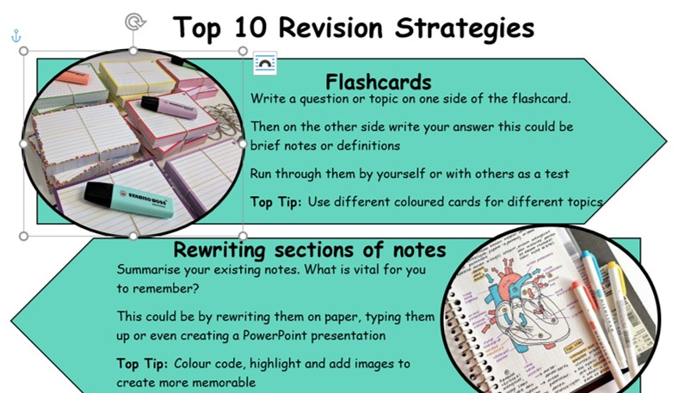
What should they be doing?
Flashcards
Re-writing notes
Mind maps
Knowledge organisers
Posters
Quizzes
Past Paper Questions
Support For Families: Supporting your child through exams
Notes:
It is very important to processes the information
Re-reading notes or reading notes from a revision guide or website page is next to pointless due to how our brains work
Quizzing is excellent and you can get involved (if they let you)
If your child has been revising for weeks, encourage them to try past paper questions – they can ask their teachers for these

Slide 20
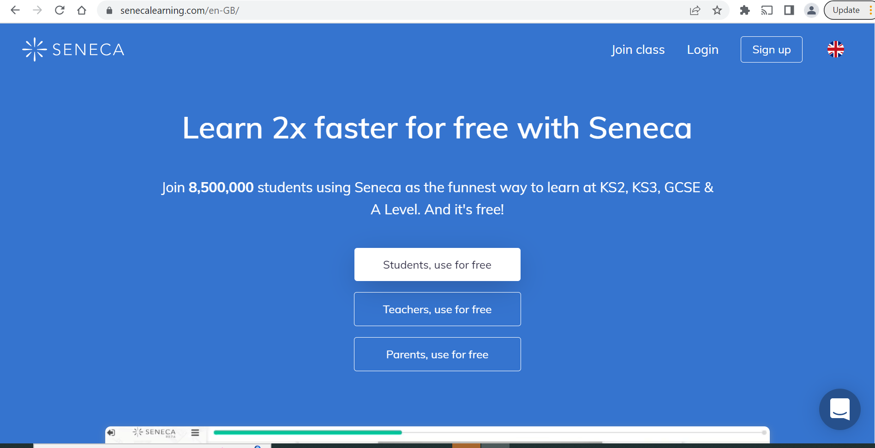
What should they be doing?
Support For Families: Supporting your child through exams

Slide 21
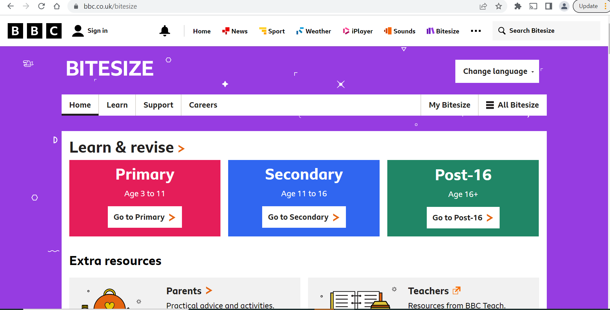
What should they be doing?
Support For Families: Supporting your child through exams

Slide 22

Finally….reassure them
1. It is not too late to do some revision
2. These exams are a chance to show what they can do but also to make mistakes and learn from them at a time when the stakes are lower
3. Even in the “real” exams, grades do not define us. Being able to say we did our best and are proud of what we’ve achieved, that’s an ACE feeling!
Support For Families: Supporting your child through exams
Notes:
We are here to help. Students who are anxious should talk to their tutor in the first instance

